Slide 1


Training of deep Spiking Neural Networks (SNN) via hybrid conversion
EE 599 Deep Learning Spring 2020
Presented by,
Akshay Manjunath
Gourav Datta
Muhammad Waqas
Mentor: Souvik Kundu

Slide 2
Overview
Use the weights and firing thresholds of an SNN converted from an ANN as the initialization step for STDB
ANN-SNN Conversion
Train ANN model
Approach 1
Motivation
Approach 2
Perform STDB with a novel surrogate gradient function using neuron’s spike time
Present a computationally-efficient training technique for deep SNNs
Train an ANN with ReLU neurons using gradient descent
ANN –SNN conversion
+
Spike –timing dependent backpropagation (STDB)
Train the initialized network with STDB to obtain an SNN that converges within few epochs at a reduced latency
Framework
Pytorch
Datasets
MNIST
CIFAR-10
Architectures
LeNet5
VGG16

Slide 3
Motivation
Spiking Neural Networks (SNNs) promise higher energy efficiency in neuromorphic hardware implementations.
SNNs obtained through ANN – SNN conversion using suitable threshold balancing incur large latency leading to higher energy consumption.
Proposed solutions consist of two approaches
Conversion from traditional ANN to SNN with an appropriate threshold scaling.
A hybrid training technique which combines ANN-SNN conversion and training SNNs with spike-based backpropagation.
Evaluate our approaches on SNN architectures like VGG and LeNet on CIFAR10 and MNIST datasets respectively.
Achieve iso-accuracy compared to similar ANN architectures at lower compute cost and energy.

Slide 4
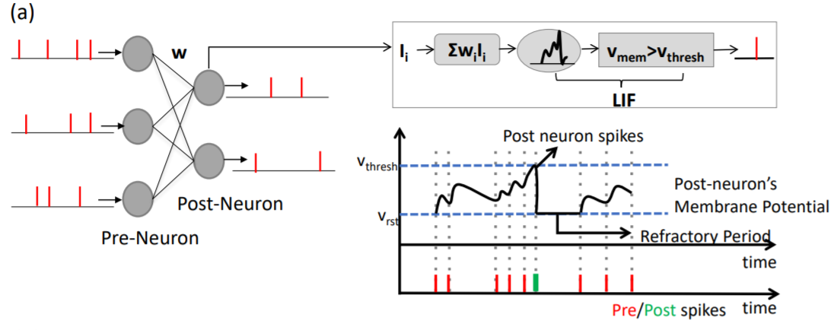
Spiking Neural Networks
Spiking neural networks (SNNs) use biologically-realistic models of neurons to carry out computation.
SNNs operate using spikes. The occurrence of a spike represents the membrane potential of the neuron.
Once a neuron reaches a certain potential, it spikes, and the potential of that neuron is reset. Most common model for this is the Leaky integrate-and-fire (LIF) model.
This type of information encoding is very robust to errors because a failure to detect a spike or two doesn’t induce a significant error on the average spike rate.
A feedforward fully-connected SNN architecture with Leaky-Integrate-and-Fire (LIF) spiking

Slide 5
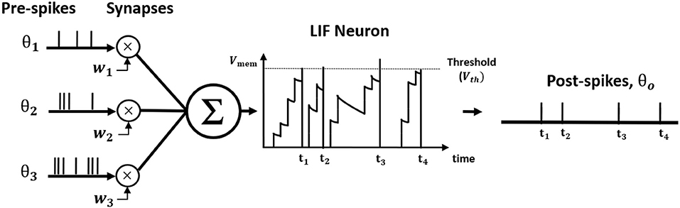
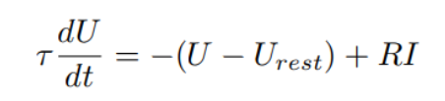
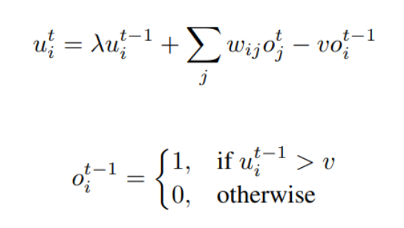
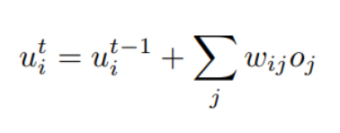
Spiking Neuron Model
The differential equation widely used to characterize the leaky-integrate-and-fire (LIF) neuron model is described by
The iterative model for a single post-neuron is described by
The dynamics of the neuron in the output layer is described by
Illustration of Leaky Integrate and Fire (LIF) neuron dynamics

Slide 6
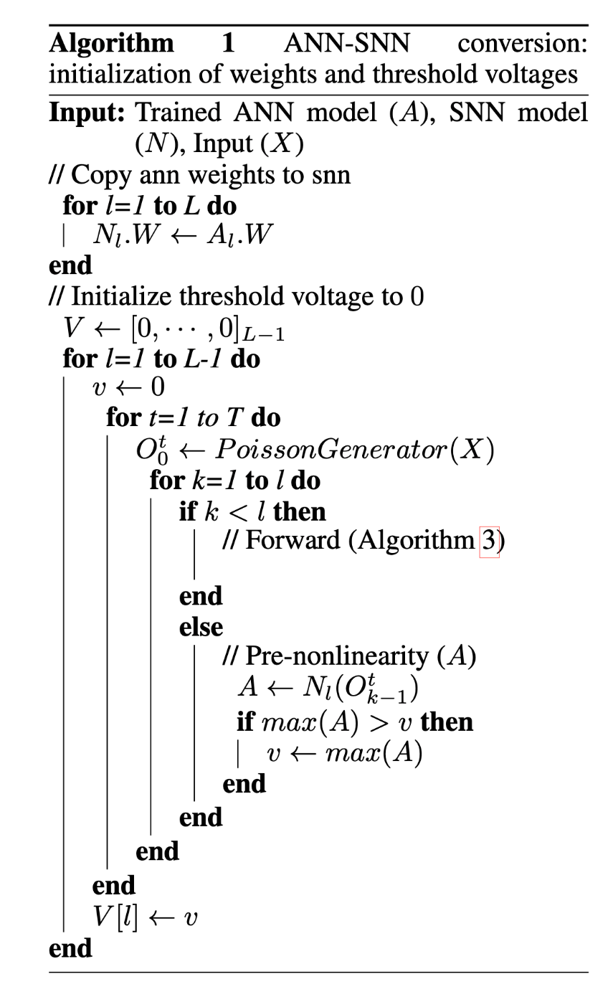
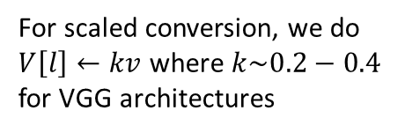
ANN-SNN conversion
We propose to use the ANN – SNN conversion process as an initialization technique for STDB.
The threshold voltages in SNN needs to be adjusted based on the ANN weights.
To achieve this we employ threshold-balancing where the weights are unchanged and the threshold is set to the normalization factor.
Normalization factor corresponds to the maximum neuron activation for the corresponding convolution/linear layer in SNN.
For scaled conversion, we do $V\left[l\right]←kv$ where $k\sim 0.2−0.4$
for VGG architectures

Slide 7
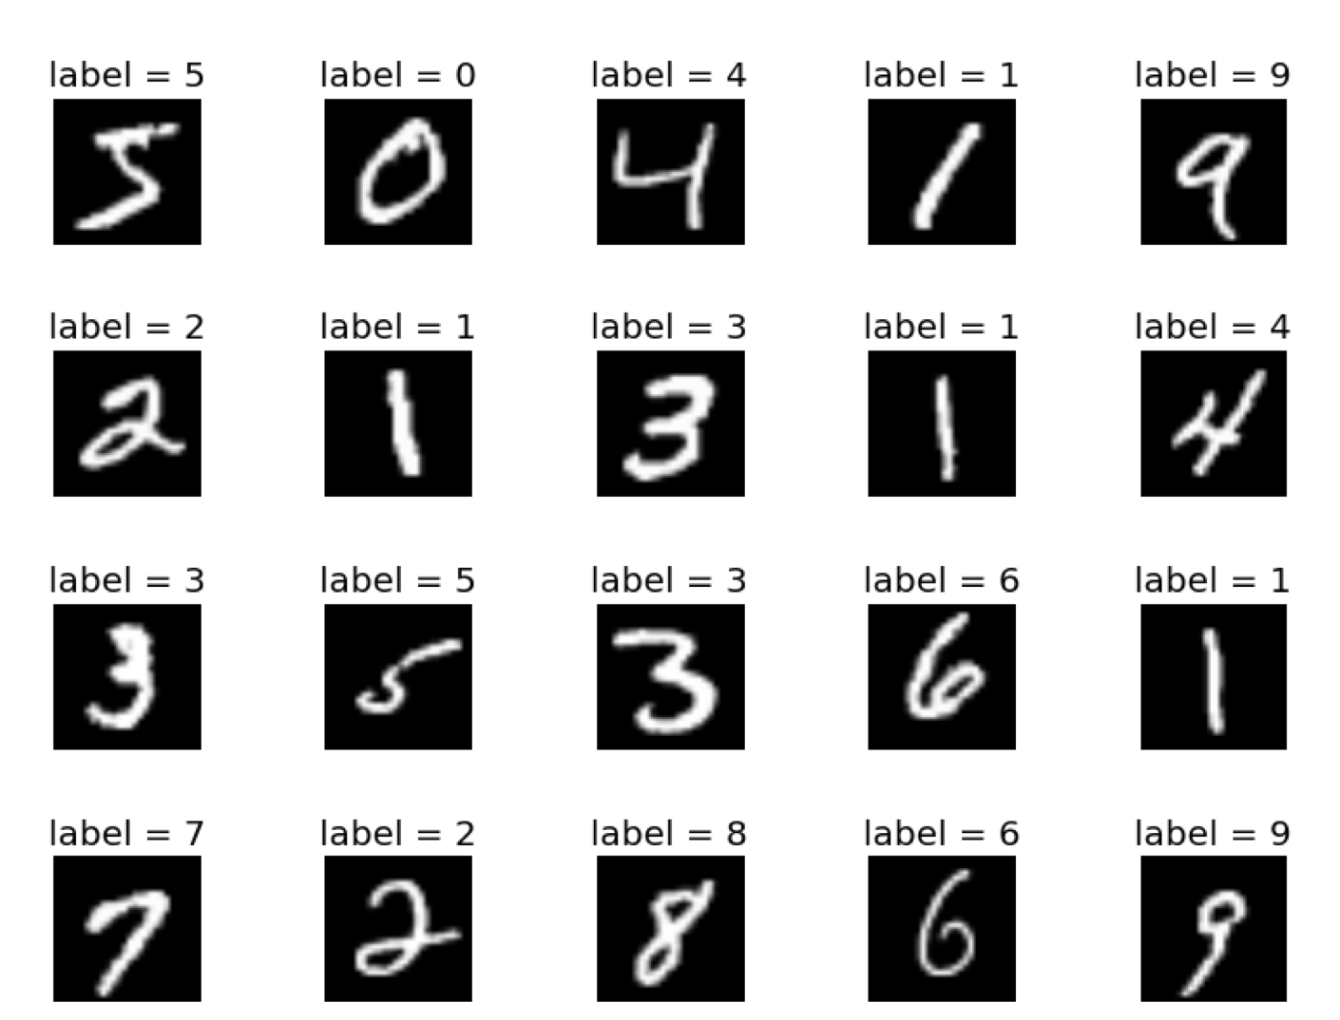
Dataset Description
MNIST for digit classification (http://yann.lecun.com/exdb/mnist/)
60,000 training examples in 10 classes.
10,000 test examples.
Each greyscale image is 28 x 28, representing the digits 0-9.

Slide 8
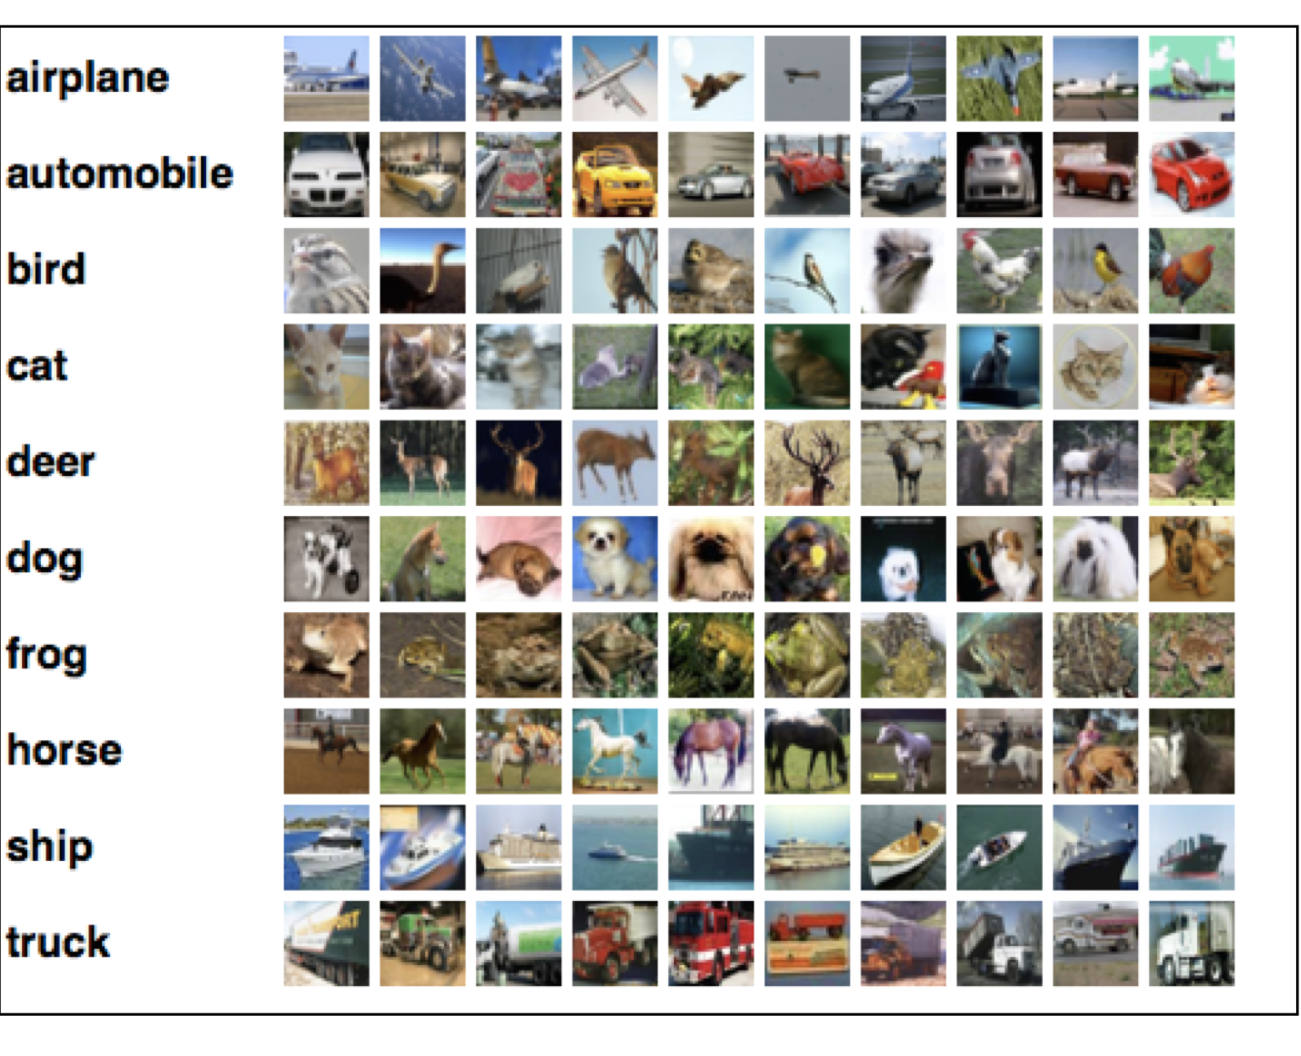
Dataset Description
CIFAR-10 (https://www.cs.toronto.edu/~kriz/cifar.html)
60,000 32x32 color images in 10 classes.
6,000 images per class.
50,000 training images and 10,000
test images.
Each color image is 32 x 32 in size.

Slide 9
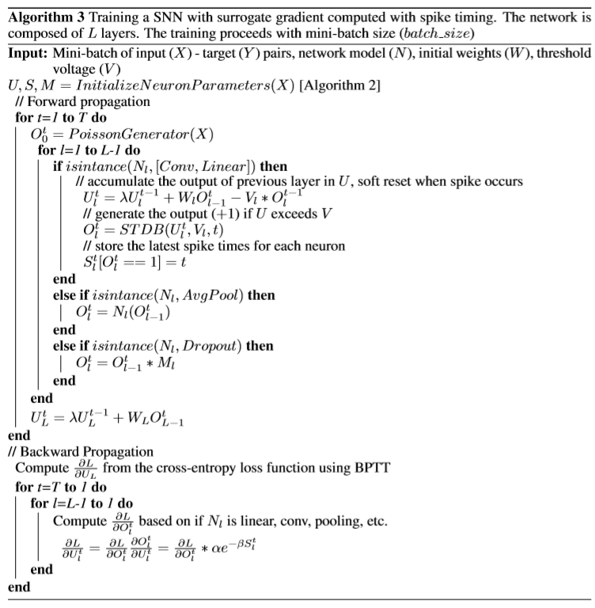
We propose to use the ANN – SNN conversion process as an initialization technique for STDB.
The threshold voltages in SNN needs to be adjusted based on the ANN weights.
To achieve this we employ threshold-balancing where the weights are unchanged and the threshold is set to the normalization factor.
Normalization factor corresponds to the maximum neuron activation for the corresponding convolution/linear layer in SNN.
For scaled conversion, we do $V\left[l\right]←kv$ where $k\sim 0.2−0.4$
for VGG architectures

Slide 10

Classification Results (Top-1) for MNIST and CIFAR-10
Architecture | ANN | ANN-SNN Conversion (T=2500) | ANN-SNN Baseline Conversion (reduced time steps) | Hybrid Training(ANN-SNN conversion+STDB)
CIFAR-10
VGG5 | 87.96 | 86.84 | 85.97 (T=200) | 86.79 (T=200)
 |  |  | 85.46 (T=100) | 86.49 (T=100)
VGG9 | 91.37 | 91.11 | 89.96 (T=200) | 90.46 (T=200)
 |  |  | 85.12 (T=100) | 88.89 (T=100)
VGG16 | 92.55 | 92.48 | 91.13 (T=200) | 92.03 (T=200)
 |  |  | 84.64 (T=100) | 91.13 (T=100)
MNIST
LENET5 | 98.83 | 98.91 | 98.82 (T=100) | 98.88 (T=100)
Optimal scaling factor for ANN-SNN Conversion in VGG architectures $\sim$ 0.7-0.9
STDB Training is performed for $\sim$ 5 epochs due to high SNN training time

Slide 11
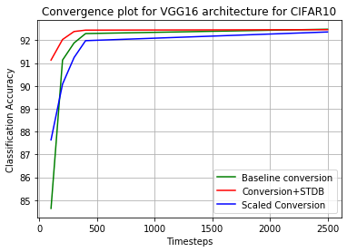
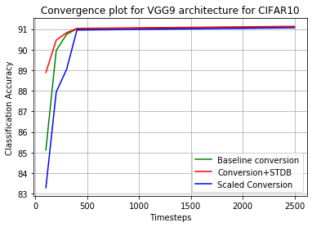
Convergence plots for VGG architectures

Slide 12
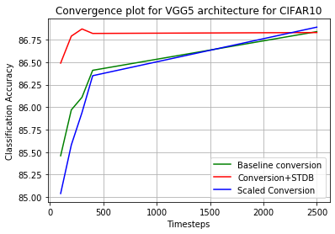
Performance of baseline conversion is similar to that of STDB for timesteps more than 200.
Scaled conversion performs worse than the other two approaches
VGG-architectures converge within 400 timesteps for all the three architectures

Slide 13
Comparison with other SNN models on CIFAR10
Model | Training Method | Architecture | Accuracy | Timesteps
Hunsberger & Eliasmith (2015) | ANN-SNN Conversion | 2Conv, 2Linear | 82.95 | 6000
Cao et al. (2015) | ANN-SNN Conversion | 3Conv, 2Linear | 77.43 | 400
Sengupta et al.(2019) | ANN-SNN Conversion | VGG16 | 91.55 | 2500
Lee at al. (2019) | Spiking BP | VGG9 | 90.45 | 100
Wu et al. (2019) | Surrogate gradient | 5Conv, 2Linear | 90.53 | 12
This work | ANN-SNN Conversion | VGG16 | 91.13 | 200
 | ANN-SNN Conversion and STDP | VGG16 | 92.03 | 200

Slide 14
Conclusion
Spiking Neural Networks (SNNs) are energy-efﬁcient and can lead low-power neuromorphic hardware implementations.
Direct training of SNN is computationally expensive and slow.
The direct training of SNN with backpropagation is computationally expensive and slow, whereas ANN-SNN conversion suffers from high latency. To address this issue we proposed a hybrid training technique for deep SNNs. We took an SNN converted from ANN and used its weights and thresholds as initialization for spike-based backpropagation of SNN. We then performed spike-based backpropagation on this initialized network to obtain an SNN that can perform with fewer number of time-steps. The number of epochs required to train SNN was also reduced by having a good initial starting point. The resultant trained SNN had higher accuracy and lower number of spikes/inference compared to purely converted SNNs. The backpropagation through time was performed with surrogate gradient deﬁned using neuron’s spike time that captured the temporal information and helped in reducing the number of time-steps. We tested our algorithm on MNIST and CIFAR10 datasets and achieved

Slide 15
Bias in Neural Units will make ANN-SNN conversion process more difficult so no bias term is used, therefore Batch Normalization techniques cannot be used as a regularizer during the training process since it biases the inputs to each layer of the network to ensure each layer is provided with inputs having zero mean.
Average Pooling instead of Max Pooling: Since the neuron activations are binary in SNNs instead of analog values, performing max-pooling would result in significant information loss for the next layer. Consequently, we consider spatial-averaging as the pooling mechanism in this work.

